Slide 1
Digital Portfolio
STUDENT NAME: Srisakthi R
REGISTER NO AND NMID: 2428C0520, CE7B44D4C5876F695E749C73803ECA97
DEPARTMENT: Bsc AI & ML
COLLEGE: KPR College of Arts & Science, Bharathiar University

Slide 2
PROJECT TITLE
Event Organizer Portfolio Website

Slide 3


AGENDA
Problem Statement
Project Overview
End Users
Tools and Technologies
Portfolio design and Layout
Features and Functionality
Results and Screenshots
Conclusion
Github Link
3/21/2024 Annual Review

Slide 4

PROBLEM STATEMENT
Organizing events requires proper planning, communication, and
documentation. Traditional methods (posters, WhatsApp messages,
word-of-mouth) lack professionalism and visibility.
A digital portfolio helps showcase the organizer’s event management
skills, past events, and achievements in a structured way, building
trust with institutions, sponsors, and participants.

Slide 5

PROJECT OVERVIEW
The Event Organizer Portfolio website highlights event management
skills, showcases organized events, and provides easy access for
participants, judges, and collaborators.
It acts as a professional platform to present achievements,
improve credibility, and attract future opportunities.

Slide 6

WHO ARE THE END USERS?
- College Management
- Event Participants
- Judges & Mentors
- Sponsors & Partners
- Fellow Event Organizers

Slide 7

TOOLS AND TECHNIQUES
- HTML5
- CSS3 (3D Effects, Gradients)
- JavaScript (Interactivity)
- GitHub Pages (Deployment)
- VS Code (Development)

Slide 8
POTFOLIO DESIGN AND LAYOUT
- Stylish, modern design with 3D card hover effects
- Sections: About, Projects, Contact
- Responsive layout for desktop and mobile
- Event-themed colors (Gold & Dark Blue)
- Smooth navigation with sticky navbar
8

Slide 9
FEATURES AND FUNCTIONALITY
- About section introducing the Event Organizer
- Event Projects displayed as interactive cards
- Contact form for networking and event inquiries
- Responsive design for multiple devices
- Deployed online via GitHub Pages for global access

Slide 10

RESULts:
- A live, working Event Organizer Portfolio website
- Easy way to showcase past events and achievements
Professional online presence
3/21/2024 Annual Review
10

Slide 11
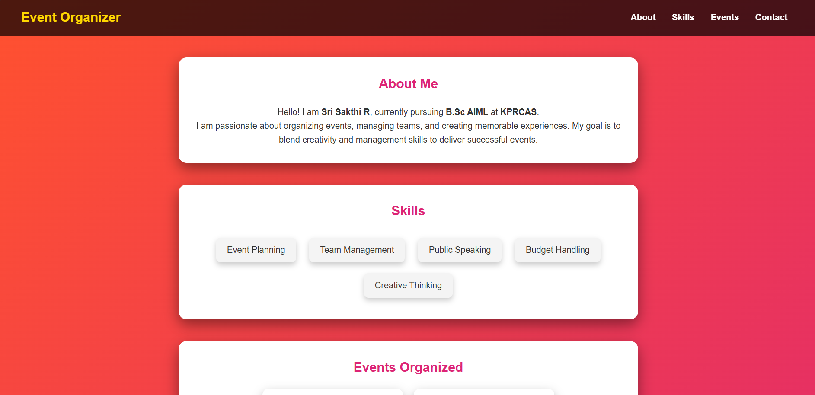
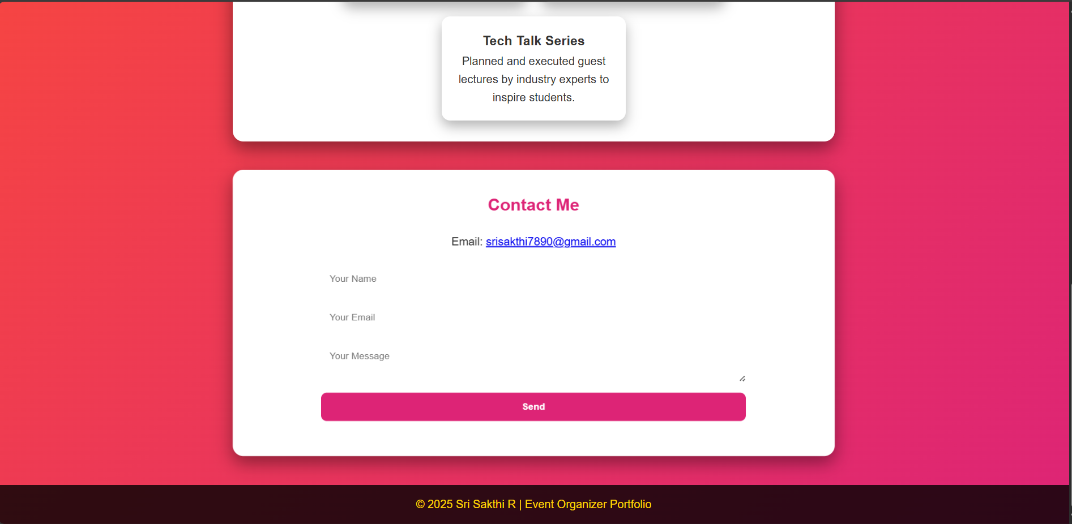
Screen Shot:

Slide 12
CONCLUSION
The Event Organizer Portfolio provides a professional platform to
showcase skills, projects, and achievements in event management.
It builds trust, improves visibility, and opens up opportunities for
collaboration and sponsorship.
Future Scope:
- Adding a calendar for upcoming events
- Integration with social media (Instagram, LinkedIn)
- Event registration and ticketing features
12

Slide 13
Git hub Link: Portfolio Repository: https://github.com/sris16/student-portfolio

